Slide 1


SENIOR DESIGN PROJECT RUNON
ESRA AY-150709002
BURAK EKEN-150709017
MUĞLA SITKI KOÇMAN UNIVERSITY
COMPUTER ENGINEERING DEPARTMENT
ADVISOR: TUĞBA SÜZEK

Slide 2
GOAL:
Develop a serious game that incentivize physical activity.

Slide 3
MOTIVATION:
Adopting a sedentary lifestyle, increasing the incidence of obesity and some chronic diseases
It's boring for people to do cardio
In other applications that encourage sports, the user can not do sports in the desired location
Too much time is wasted on games in everyday life.

Slide 4


MARKET ANALYSIS:
Pokémon GO
Similarity: encourages physical activity
Difference: only be played outdoors
Zombies, Run!
Similarity: turns exercise into a game
Difference: using just voice records

Slide 5
DIFFERENCES
Turkish language support,
Unlike others, it can be played anywhere.
Provided to compete with people of their own choosing.

Slide 6
BENEFITS OF PROJECT
The time waste on the game will be turn into quality physical activity.
The user will be allowed to play anywhere.
Multiplayer application will be connected to social media accounts to create a list of friends.

Slide 7
WORK DONE SO FAR
Sensors and libraries to be used were searched.
Qt was downloaded and libraries were imported.
Tubitak 2209-A program was applied.
The seminar about Multi-Player Gaming Tips and Tricks was attended. After the seminar Unity was decided to use.
Unity was downloaded and sensor libraries were searched.

Slide 8
WORK DONE SO FAR
Accelerometer and gyroscope data started to be collected in Unity.
Sample code about location was written.
Github repository was created.
https://github.com/E-can-comp/RunOn

Slide 9
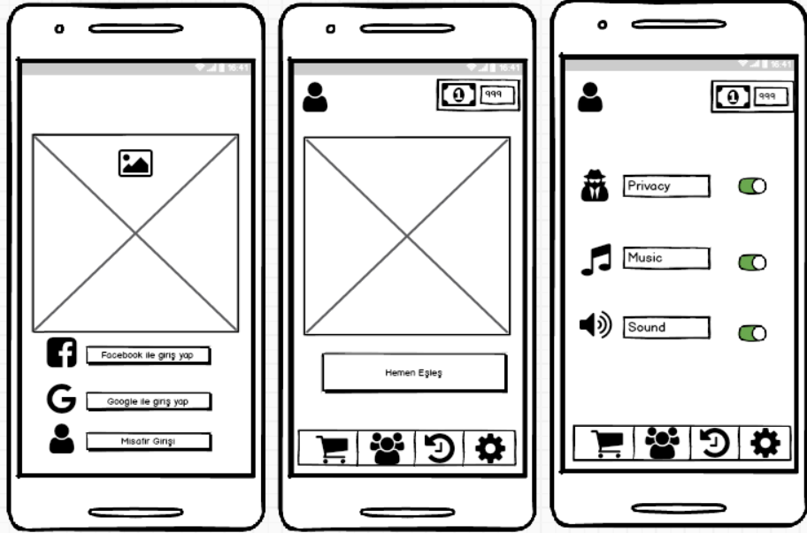
GUI PROTOTYPE

Slide 10
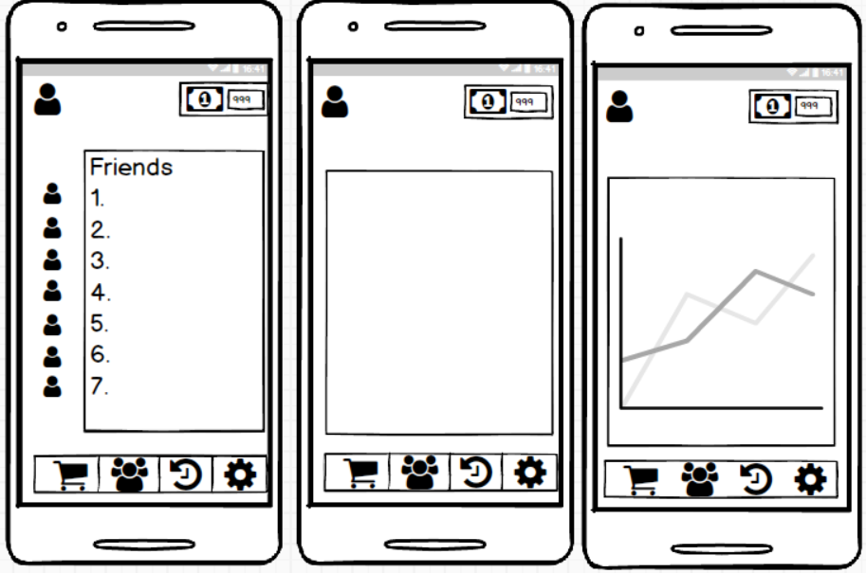
GUI PROTOTYPE

Slide 11
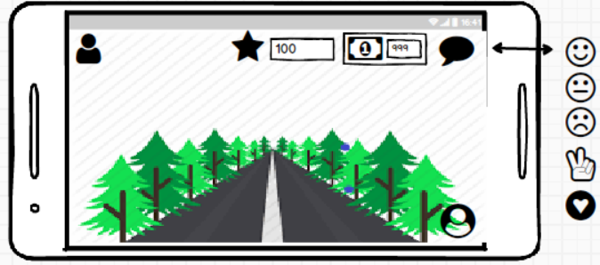
GUI PROTOTYPE

Slide 12
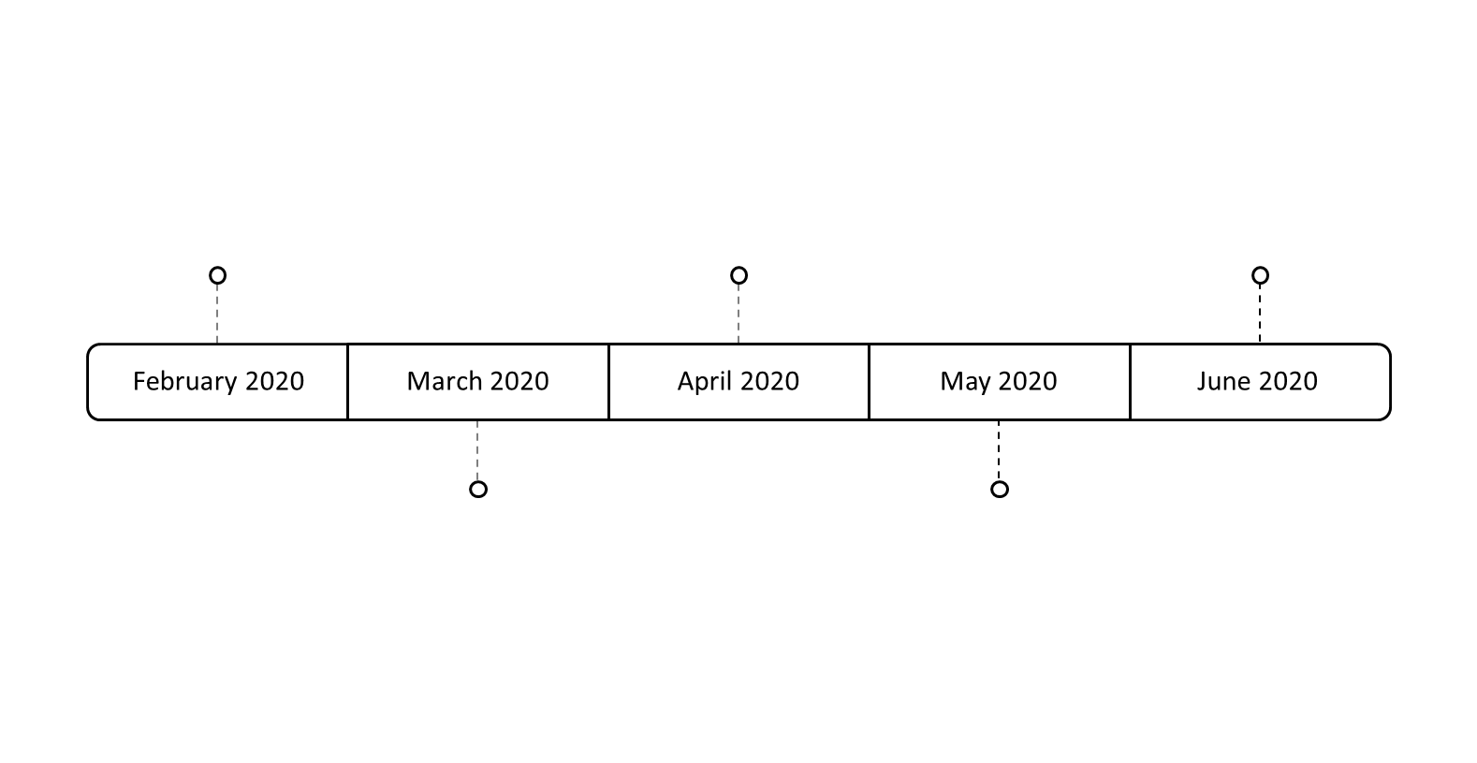
PROPOSED PROJECT TIME
Collecting Sample Data from the Smart Phone with Accelerometer
Mobile Application Interface
Testing Application
February 2020
March 2020
April 2020
May 2020
June 2020
Preprocessing of Data
Using Data in Mobile Application

Slide 13
THANKS FOR LISTENING
esraaay123@gmail.com
burakeken96@gmail.com

